Slide 1

Retail Customer Churn Exploratory Data Analysis
Shreyas Anand

Slide 2
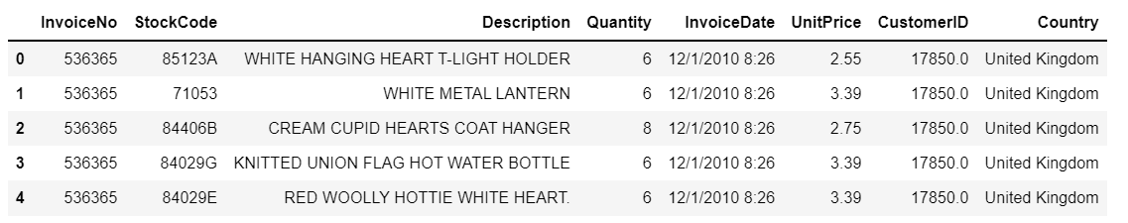
Raw File Summary
541,909 Retail Transaction Records

Slide 3

Cleaning the Raw File
135080 Transactions that had no Customer ID dropped from the analysis
These most likely are stock adjustment transactions not involving a customer
Rest 406,829 transactions were further analysed.
Invoice Date column converted from text to Date-Time format to enable Date based analysis.

Slide 4
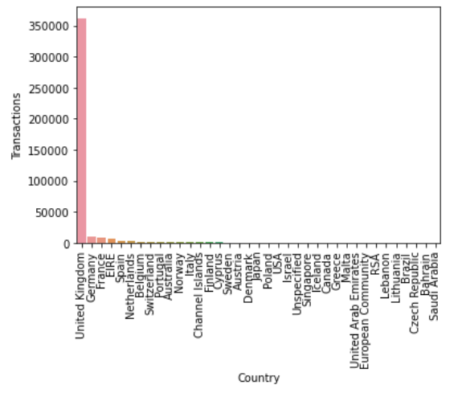
Transaction Data Statistics
Invoice Date Range is about 1 year from Dec 1, 2010 to Dec 9, 2011
The transactions are for 37 countries
89% Transactions are from the United Kingdom
There are 4372 unique customers
Number of Transactions per customer range from 1 to 7983 per customer

Slide 5
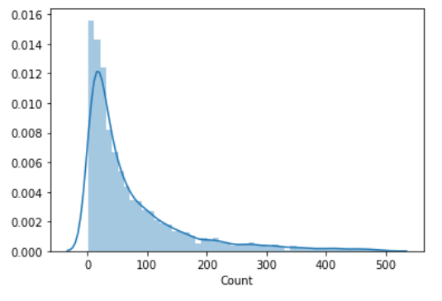
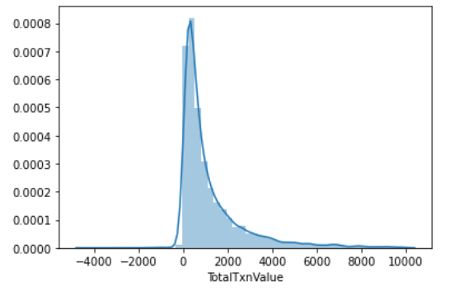
Transaction Data Statistics
Bulk of the customers have up to 100 transactions
Bulk of Customers have total purchase up to 1000 Dollars during the year

Slide 6
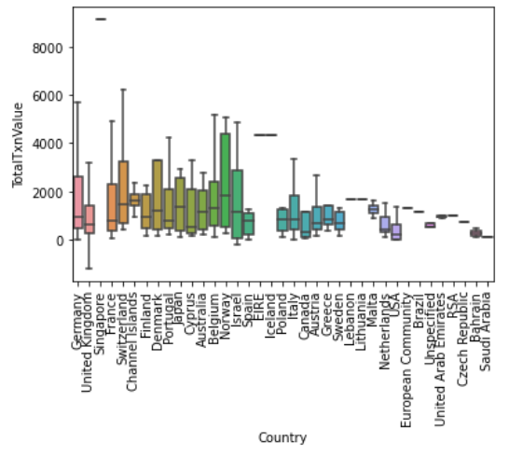
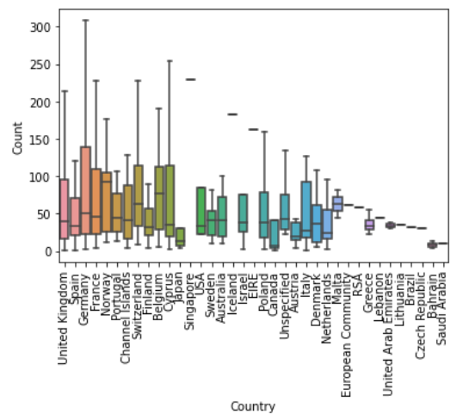
Transaction Data Statistics
Customers in some European countries like Germany and Norway have significant count of purchases and value of purchases although they are fewer in number than in the UK

Slide 7

Observations
Maximum Cancellations by a single customer in the one year period are 226
Number of Cancellations are around 2% of the transactions during the year
Cancellations/Returns may be due to bad product quality and may lead to customer churn.

Slide 8

Recommendations
The retailer can target the European Countries to acquire more customers
Steps could be taken to reduce the percentage of cancellations/returns.

